Slide 1


“Does he have sharp eyes or sharp lungs?”
Expressions of emotion and character in Makasae
Francisca Cecilia X. dos Santos
Dili institute of Technology
7th East Nusantara Conference
14/5/2018

Slide 2
Makasae
Papuan
124,000 speakers, 10% of East Timor’s population (2015 census)
SOV

Slide 3
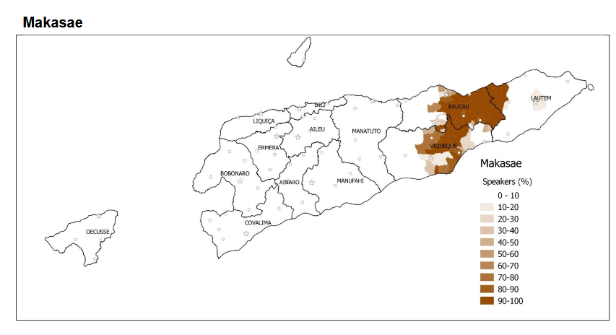
Location of Makasae speakers
Williams-van Klinken & Williams, 2015

Slide 4

Emotion and character
Mostly collocations of a body part noun and an adjective, verb, noun or number
Makasae | Literal | Meaning
sada mera | lungs sharp | furious
da’e ria | head run | 1. unfaithful to spouse; 2. creative thinker
da’e afakai | head flintstone | stubborn, refuse to listen
ari u | liver one | unity

Slide 5
Structure: 2 constructions
Subject = person + body part, predicate = characteristic
Subject = person, predicate = body part + characteristic.
Tino | gi | da’e | geele, | estuda | to | tama.
Tino | pos | head | hard | study | not | enter
‘Tino is a slow learner, even when he studies he doesn’t learn.’
Tino | ere | da’e | geele.
Tino | this | head | hard
‘Tino is a slow learner.’
Notes:
Tetun Dili has the same two constructions, even though it is an unrelated language.

Slide 6
Negation
Negative can precede just the second part of the expression, or the whole expression.
Bete | gi | da’e | to | geele.
Bete | pos | head | not | hard
‘Bete is not a slow learner.’
Bete | ere | to | da’e | geele.
Bete | this | head | not | hard
‘Bete is not a slow learner.’
Notes:
Lexicalised: relatively fixed combination of morphemes and meaning
The two words can be treated as a single expression (a compound), but can also be separated by ‘not’ or ‘very’.

Slide 7
Intensification and comparatives
lita ‘very/more’ precedes just the second part of the expression when it means ‘very’. In comparatives it precedes the whole expression.
Bete | gi | da’e | lita | geele.
Bete | pos | head | very | hard
‘Bete is a very slow learner.’
Bete | gi | lita | da’e | geele.
Bete | 3s | very | head | hard
‘Bete is a slower learner than her.’
Notes:
Lexicalised: relatively fixed combination of morphemes and meaning
The two words can be treated as a single expression (a compound), but can also be separated by ‘not’ or ‘very’.

Slide 8
da'e “head”: intelligent, faithful
Makasae | Literal | Meaning
da'e losa | head empty | 1. bald; 2. stupid
da'e geele | head hard | slow learner
da'e momala | head soft | fast learner
da'e wee | head have | smart
da'e koulu | head hot | 1. fever; 2. speak nonsense
da'e afakai | head flintstone | stubborn, refuse to listen
da'e ga | head tight | naughty
da'e gira gira | head crazy | having many love affairs
da'e ria | head run | 1. unfaithful to spouse; 2. creative thinker
Notes:
Some have 2 meanings
Head hot (physical and metaphorical
Head run 2 metaphors (1. intelligence; 2. faithfulness)

Slide 9
mutu “inside”: feel, know, character
Makasae | Literal | Meaning
mutu sisiiri | inside pain | 1. angry; 2. jealous, envious
mutu sege | inside difficult | angry
mutu taba | inside hole | able to manage things
mutu meta | inside black | know nothing
mutu molu | inside lose | innocent
mutu loloro | inside straight | aware
mutu nogo nogo | inside fool | foolish
mutu rau | inside good | kind
mutu saree | inside clean | honest
mutu u | inside one | united

Slide 10
fanu “face”: angry, crazy, absent, dead
Makasae | Literal | Meaning
fanu koulu | face hot | angry
fanu teulu | face smog | scowl
fanu gira-gira | face crazy | Crazy
fanu kuili | face curve | crazy
fanu saree | face clean | sober (not drunk), normal (not crazy)
fanu molu | face lose | absent from ceremony, dead
fanu meta | face black | dizzy, unconscious
fanu kamera | face camera | loves to be in photos (slang, calque on Tetun)
Notes:
Metaphorical term is used even if the person’s face does not show anger
Fanu kuili (face curve)“crazy (e.g. wander around aimlessly, violent, talk nonsense)”

Slide 11
tana “hand”: contribute, diligent; throw straight
Makasae | Literal | Meaning
tana asana | hand long | habitual thief; 2. able to contribute much in a traditional ceremony
tana digaara | hand short | unable to contribute much in traditional ceremony
tana molu | hand lose | don’t contribute anything in traditional ceremony
tana lafu | hand life | diligent, fast worker
tana lawa | hand money | do nothing when others are working
tana uruwatu | hand God | do nothing when others are working
tana biiki | hand bitter | plants die when this person picks its leaves
tana lolooro | hand straight | always throw straight to the target

Slide 12
nana “eye”: able to see, awake; untrustworthy
Makasae | Literal | Meaning
nana deta | eye ripe | blind (can’t see anything), don’t notice something
nana ifi | eye worm | can't see something that you should be able to see
nana taba | eye hole | have the ability to see supernatural beings
nana afa | eye stone | able to stay up for two days and nights or more
nana fani | eye sweet | feel wide awake after a sleep
nana sare’e | eye clean | feel wide awake after a sleep
nana ifibere | eye star | not sleepy
nana mera | eye sharp | love touching people's stuff without asking
nana ria ria | eye run | have a girl in every town

Slide 13
wali “ear”: able to hear; naughty
Makasae | Literal | Meaning
wali deta | ear ripe | deaf, can't hear at the time of speaking
wali lolooro | ear straight | able to hear something that others can’t hear
wali ifi | ear worm | naughty
wali noo | ear pocket | naughty

Slide 14
muni “nose”: smell; able to find things
muni gi | nose grimace | cry
muni kula | nose mushroom | animal) can’t smell something
muni looro | nose straight | 1. able to find things that the owner denies having 2.able to smell something that others can’t smell”
Notes:
Have sharp nose
Comparing to dog smelling things

Slide 15

a’a “mouth”: talkative
Makasae | Literal | Meaning
a’a bere | mouth big | Talkative, talk a lot
a’a sege | mouth difficult | putting down
Notes:
Also hear nuu (from other dialects)

Slide 16
gula “body”: energetic
Makasae | Literal | Meaning
gula ae’e | body light | feel fresh, energetic, ready to do things
gula tiiri | body heavy | lazy, feel bored, unmotivated
gula dafuuru | body cooked | feel tired
gula koulu | body hot | say, buy, or do something that is not necessary (e.g. overact)

Slide 17
sada “lungs”, waboku ‘heart’: feel
Makasae | Literal | Meaning
sada taur | lungs break | skinny
sada mera | lungs sharp | furious
sada fatu | lungs swollen | broken-hearted (slang)
waboku sisiiri | heart pain | physical pain in heart; feel heart-broken
Notes:
Sada fatu is teenager slang. This shows that this construction is productive.
In Tetun Dili, using ‘heart’ for the location of feelings is due to Portuguese influence. In Makasae, it is a traditional usage.

Slide 18
ari “liver”: firm
Makasae | Literal | Meaning
ari tidiini | liver firm | stand firm, brave
ari u | liver one | united

Slide 19
atu “stomach”: greedy, worried
Makasae | Literal | Meaning
atu geele | stomach hard | greedy
atu sisiiri | stomach sore | worried, preoccupied

Slide 20
Other
Makasae | Literal | Meaning
atugu’u ifi | buttock worm | rarely at home, always out hanging around with friends; 2. restless, always moving about when sitting on a seat
atugu’u ti’iri | buttock heavy | lazy
namu lesa | body.hair not.have | having nothing (properties)
para baga | hip wound | wear sarong, skirt, pants not properly

Slide 21
Conclusion
Lexicalised, but the two parts of the expression can be separated.
Productive:
  16 body parts
  Can create new expressions, or create literal translations from Tetun.
Metaphorical:
  One expression can have a physical and a metaphorical meaning, or two different metaphorical meanings.

