Slide 1
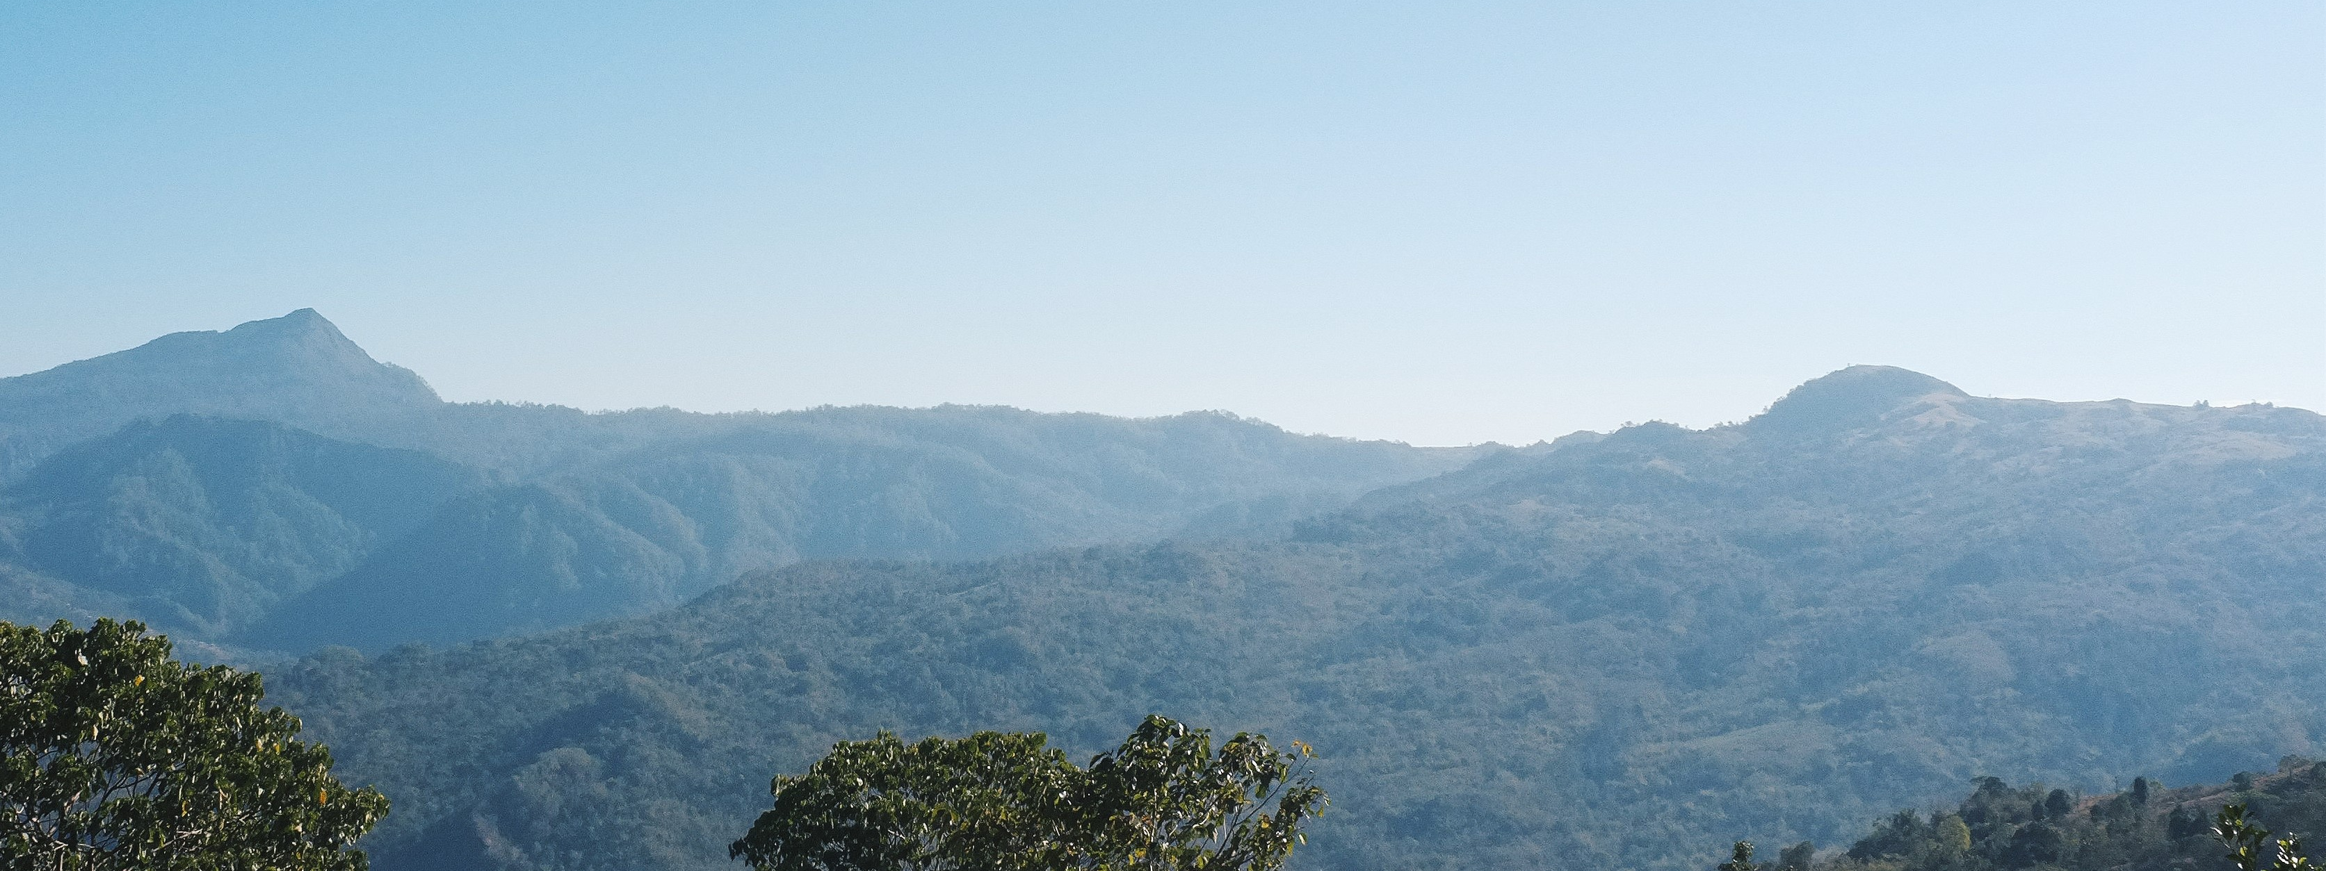
Amfo'an consonant insertion: Diachronic origins
ENUS7
Kirsten Culhane
The Australian National University

Slide 2
Consonant insertion in Amfo'an
Amfo'an attests processes of synchronic consonant insertion by which the segments /ʤ/ /ɡ(w)/ and /l/ are inserted after vowel final words in range of phonological and syntactic environments
Regular and predictable based on the preceding vowel: /ʤ/ is inserted after /i/, /l/ after /e/ and /ɡw/ after /o/ and /u/
Consonants are inserted when a vowel final word is followed by a vowel initial enclitic
1)
Ai | + | =es | → | aiʤes | ‘one fire’
kee | + | =es | → | keeles | ‘one turtle’
kiu | + | =es | → | kiuɡwes | ‘one tamrind fruit’

Slide 3
Consonant insertion in Amfo'an
Consonants are inserted after vowel final words when they occur at the end of a noun phrase
This presentation will demonstrate that the inserted segments are not a result of retention, but an innovation and demonstrate that the inserted segments are a result of regular sound change
2)
 | ‘rope’ | ‘house’ | ‘bird’ | ‘dog’
Phrase-Medial | tani | ume | kolo | asu
Phrase-final | taniʤ | umel | koloɡ | asuɡ

Slide 4
Presentation outline
Introduction
Overview of consonant insertion(s) in Amfo’an
Retention?
Innovation
Proposed account
Conclusions

Slide 5
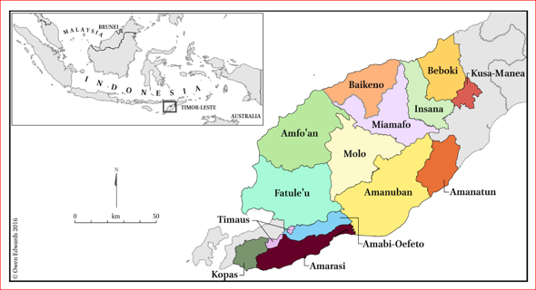
Introduction
Amfo’an is a variety of Meto: a cluster of closely related Austronesian languages and dialects spoken on the western part of the island of Timor.
Figure 1: Self-identified varieties of Uab Meto (Edwards 2016)

Slide 6
introduction
Final consonant insertion is a distinctive feature of Amfo’an and is highly salient to speakers
more than 14 different dialects of Amfo’an
Dialects have distinct lexical and morphophonological differences
All dialects demonstrate processes of consonant insertion
The data in this presentation is from the Nai'Bais dialect of Amfo’an as spoken in the desa (villages) of Lelogama and Fatumonas

Slide 7
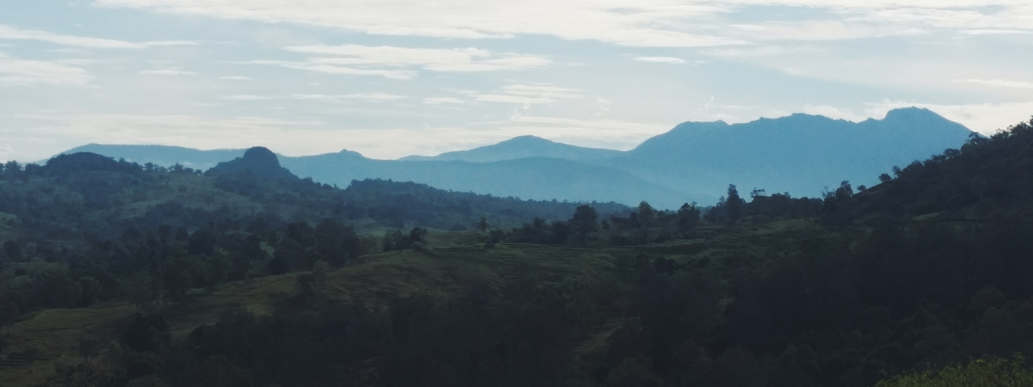
Synchronic consonant Insertion(s) in Amfo'an

Slide 8
Insertion before vowel-initial enclitics
If a vowel-final clitic host is followed by a vowel-initial enclitic, consonant insertion occurs
3)
fai | + | =es | → | faiʤes | ‘one night’
noe | + | =es | → | noeles | ‘one river’
meo | + | =es | → | meoɡwes | ‘one cat’
hau | + | =es | → | hauɡwes | ‘one tree’

Slide 9
Insertion before vowel initial enclitics: nouns
If CV final, consonant inserted , host undergoes metathesis + vowel assimilation
4)
fafi | + | =es | → | fafiʤes | → | faifʤes | → | faafʤes | ‘one pig’
 |  |  |  | C-insertion |  | Metathesis |  | Vowel assimilation
bale | + | =es | → | baales | ‘one place’
neno | + | =es | → | neenɡwes | ‘one day’
asu | + | =es | → | aasɡwes | ‘one dog’

Slide 10
Insertion before vowel initial enclitics: Verbs
5)
n-kai | + | =en | → | n-kaiʤen | ‘already harvested’
na-tae | + | =en | → | na-taelen | ‘already answered’
n-nao | + | =en | → | n-naoɡwen | ‘already went’
n-fani | + | =en | → | n-faanʤen | ‘already returned’
na-hine | + | =en | → | na-hiinlen | ‘already know’
n-mepu | + | =en | → | n-meepɡwen | ‘already worked’

Slide 11
Noun Phrase Final consonant insertion
4)
in | n-mees | n-bi | ume-l
3SG | 3-alone-M | 3-LOC | house
‘s/he is alone at the house’
hai | anah | a|n-toko | n-bi | ume | bubuʔ
1EX | child | 3-sit | 3-LOC | house | round
‘our children sat in a round house’

Slide 12
Noun modification
No consonant insertion if nominal is NP medial
5)
Noun | + | Modifier | → | Phrase | Gloss
sisi-ʤ ‘meat’ | + | metoʔ ‘dry’ | → | sisi metoʔ | ‘dried meat’
biʤae-l ‘cow’ | + | fui-ʤ ‘wild’ | → | biʤae fui-ʤ | ‘wild cow’
neno-ɡ ‘day’ | + | klei-ʤ ‘church’ | → | neno klei-ʤ | ‘church day’ (ie Sunday)
asu-ɡ ‘dog’ | + | anaʔ ‘small’ | → | asu anaʔ | ‘small dog’

Slide 13
Functions of Np-final consonant insertion
Differentiates attributive phrases and equative clauses
6)
Noun + Attribute |  | Equative clause
[NP ume anaʔ ] | ‘a small house’ | [NP umel ] [NP anaʔ] | ‘(the) house is small’
[NP fafi anaʔ ] | ‘a baby pig’ | [NP fafiʤ ] [NP anaʔ] | ‘(the) pig is small’
Differentiates ordinal and cardinal numbers
Ordinal number |  | Cardinal number
[NP neno meseʔ ] | ‘first day’ (ie Monday) | [NP nenoɡ] [NP meseʔ] | ‘one day’

Slide 14
Functions of Np-final consonant insertion
Indicates there is a 3SG object argument
7)
au ʔ-lomi | ‘I like’ | au ʔ-lomiʤ | ‘I like it’
in na-hine | ‘s/he knows’ | in na-hinel | ‘s/he knows it’
in n-inu | ‘s/he drinks’ | in n-inuɡ | ‘s/he drinks it’

Slide 15
Synchronic productivity
Consonants inserted after loan words in phrase-final position
8)
kofiʤ | ‘coffee’ | From Dutch koffie
teel | ‘tea’ | From Malay teh
fotoɡ | ‘photo’ | Ultimately from English photo
otoɡ | ‘car’ | From Dutch auto
kuluɡ | ‘teacher’ | From Malay guru

Slide 16
About /a/
There are very few /a/ final nouns in Amfo'an which would trigger consonant insertion: of the 426 nouns in my dictionary, 2 are /a/ final
9)
paha | ‘land’
tafa | ‘society’
These items are districted in their usage: paha is almost always metathesised and tafa only occurs in ritual speech.
paah pinan | lit. ‘land below’, ‘world’
paha pinan | ‘Satan’
10)

Slide 17
About /a/
If the host of a vowel-initial enclitic is Ca final, no insertion occurs
11)
paha | + =es | → | paahes | ‘one land’
na-tefa | + =en | → | nateefen | ‘already met’
na-mnaha | + =en | → | namnaahen | ‘already hungry ’
If the host of a vowel-initial enclitic is Va final, ɡw insertion occurs
12)
na-bɡua | + =en | → | na-bɡuaɡwen | ‘already ɡathered’
na-tɡoa | +=en | → | na-tɡoaɡwen | ‘already filled’

Slide 18
Non- ‘minimal’ consonant insertion
Consonant insertion in Amfo’an is not phonetically natural
This raises questions about the source of the process
Non-minimal consonant insertion processes tend to be the result of multiple changes which render the phonological basis of the insertion unclear
Amfo’an is a case of this

Slide 19
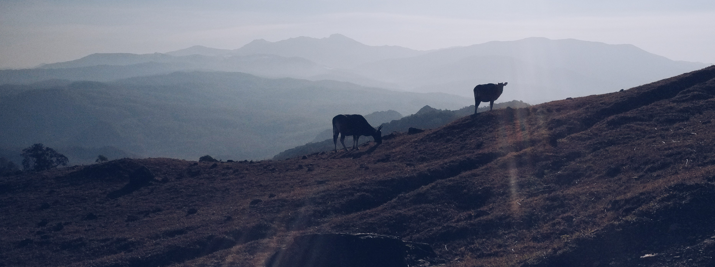
Retention?

Slide 20
Are the consonants retentions?
In Austronesian there are many instances where word final consonants were retained in certain environments, resulting in a synchronic consonant/zero alternation Eg Samoan
This is not a plausible analysis for Amfo’an: inserted consonants do not correspond to final consonants in Proto-Malayo-Polyesian
Intransitive | Transitive | POc | Gloss
inu | inu-mia | *inum | ‘drink’
taŋi | taŋi-sia | *taŋis | ‘cry’
mataʔu | mataʔu-tia | *matakut | ‘fear’
POc from Blust and Trussel (ongoing), Samoan data from Crowley and Bowern (2010):123

Slide 21
Retained consonants?
Although there are forms that look like the consonant is retained like *manuk and manuɡ- there is no correspondence between inserted consonants in Amfo’an and final consonants in Proto-Malayo-Polynesian
In Meto, PMP word-final consonants have typically been lost (Edwards 2016), with the exception of *s and *n
PMP | Amfo'an | Gloss
*salaq | n-sana | Be wrong
*mamaq | n-mama | Chew betel
*ənəm | nee | six
*əpat | haa | four
*inum | n-inu | drink
PMP from Blust and Trussel (ongoing)

Slide 22
Consonant-final forms in PMP + Amfo'an Cognates
13)
PMP | Amfo'an | Gloss | Regular sound change PMP > Meto
*Rumaq | umel | ‘house’ | *q > ø
*zauq | ʔlooɡ | ‘far’
*kemiq | miiʤ | ‘urine’
*ma-putiq | mutiʔ | ‘white’
*babuy | fafiʤ | ‘pig’ | *y > ø
*panjay | anel | ‘field rice’
*muntay | mukeʔ | ‘citrus’
*tasik | tasiʤ | ‘sea’ | *k > i_V , *k > h /#_
*manuk | manuɡ | ‘chicken’ | *k > ø elsewhere
PMP from Blust and Trussel (ongoing), PMP > Meto sound correspondences from Edwards (2016)

Slide 23
Innovation
Consonant insertion only occurs in Meto and not in Rote, and not in all varieties of Meto- indicating the process was not inherited
Corresponding forms of the enclitics that trigger consonant insertion Amfo’an demonstrate no consonant insertion in Rote:
14)
Landu | Gloss
ani=a | ‘the wind'
oe=a | ‘the water'
tane=a | ‘the mud’
keo=a | ‘the black'
ledo=a | ‘the sun'
Landu data from Owen Edwards, p.c May 2018

Slide 24
innovation
Not all varieties of Meto attest consonant insertion before enclitics
For example, in Kualin (Southern Amanuban) vowel final clitic hosts are followed by
vowel initial enclitics with no consonant inserted
15)
Kualin | Gloss
fua=ee | ‘the bean’
mii oa=ee | ‘the urine’
kfeti=ee | ‘the slingshot’
Kualin data from Owen Edwards, p.c May 2018

Slide 25
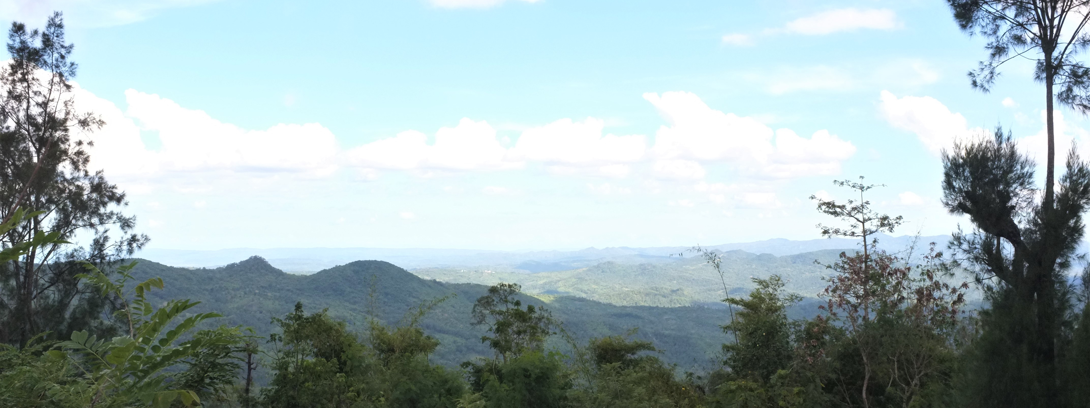
proposed Account

Slide 26
Diachronic origins of the inserted segments
/ʤ/ and /ɡ/ are not inherited; they do not correspond to any of the regular sound changes in Meto
/ʤ/ and /ɡ/ are phonologically restricted; /ɡ/ only occurs in the context of /o/ /u/, /ʤ/ only occurs in the context of /i/
Apparent that these segments are a result of glide fortition

Slide 27
Glide epenthesis + fortition
Apparent that /ʤ/ and /ɡ/ insertion is a result of epenthetic glides that underwent fortition
synchronic glide epenthesis attested in other varieties of Meto
For example, Amanuban:
17)
 |  | Amanuban | Amfo'an | ɡloss
ai + ee | → | aijee | aiʤee | ‘the fire’
meo + ee | → | meowee | meoɡwee | ‘the cat’
hau + ee | → | hauwee | hauɡwee | ‘the wood/tree’
Data from Owen Edwards, p.c February 2018

Slide 28
Word-medial Glide fortition
/ʤ/ and /ɡ/ also attested word medially
16)
Amfo'an | Other Meto | PMP | Gloss
nuɡa | nua | *duha | ‘two’
na-bgua | na-bua |  | ‘gather’
biʤaas |  |  | ‘usually’ (from Malay biasa)
a|bʤaan | bian |  | ‘other’
a|fɡue-l | foe | *buay | ‘bean’
a|pɡuah | puah | *buaq | ‘betel nut’

Slide 29
Diachronic sources of /l/ insertion
/l/ insertion is not a result of glide fortition- it is an inherited segment, resulting from *r > /l/ sound change
Amfo'an and its closest relatives (Fatule'u, Baikeno + Molo) attest insertion of /l/ after /e/ final words before vowel-initial enclitics
It is apparent that formerly, these varieties attested a process of /r/ insertion after vowel-final clitic hosts
This process is still attested in the Kusa-Manea variety of Meto

Slide 30
Kusa-manea consonant insertion
/r/ insertion after /e/ and /a/
18)
ai + aa | → | aijaa | ‘that fire’
oe + aa | → | oeraa | ‘that water’
bia + aa | → | biaraa | ‘that cow’
oo + aa | → | ooaa | ‘that bamboo’
hau + aa | → | hauwaa | ‘that tree’
Kusa-Manea data from Owen Edwards, p.c February 2018

Slide 31
Where did /r/ insertion come from?
No apparent phonological basis for /r/ insertion
no indication of where it came from
Kusa-Manea data limited- with current data, no further conclusions can be made

Slide 32
What about /a/?
Very few /a/ final words- many historically /a/ final words underwent *a > /e/ sound change
19)
PMP | Amfo'an | Gloss
*Rumaq | ume-l | ‘house’
*ma-əsa | mese | ‘alone’
*ma hataq | n-mate | ‘raw’
*qaRta ‘black person’ | ate-l | ‘slave’
It seems that there was so few /a/ final nominals that these forms became exceptions

Slide 33

Implications +conclusions

Slide 34
Conclusions
Source of /ʤ/, /ɡ/ and /l/ insertion in Amfo'an can be accounted for diachronically
Consonant insertion in Amfo'an is an innovation: inserted consonants are not historical retentions
Inserted consonants are a result of regular sound change
Process comes from a former process of glide insertion after /i/ /o/ and /u/ and /r/ insertion after /e/ and /a/
Lack of synchronic insertion after /a/ can be explained by lack of /a/ final forms; it seems there were so few /a/ final words that they became exceptions

